Slide 1
Fall 2023 Principles of Database Systems,
6083 Section B
Final Project Demo
WOW (World on Wheels) Car Rental Company
George He
Zhuo Chen
Wenxuan Hu

Slide 2
Business Case
WOW (World on Wheels) is a car rental company.
WOW has many locations at various airports, towns, and cities in the United States.
Each office location of WOW maintains various classes of rental vehicles. Each vehicle is identified by Make, Model, Year, VIN (Vehicle Identification Number), and License Plate number.
Each location has various classes of vehicle such as small car, mid-size car, luxury car, SUV, Premium SUV, Mini Van, Station Wagon etc.
WOW occasionally mails discount coupons to their customers and also mails such discount coupons to neighborhood residents.

Slide 3
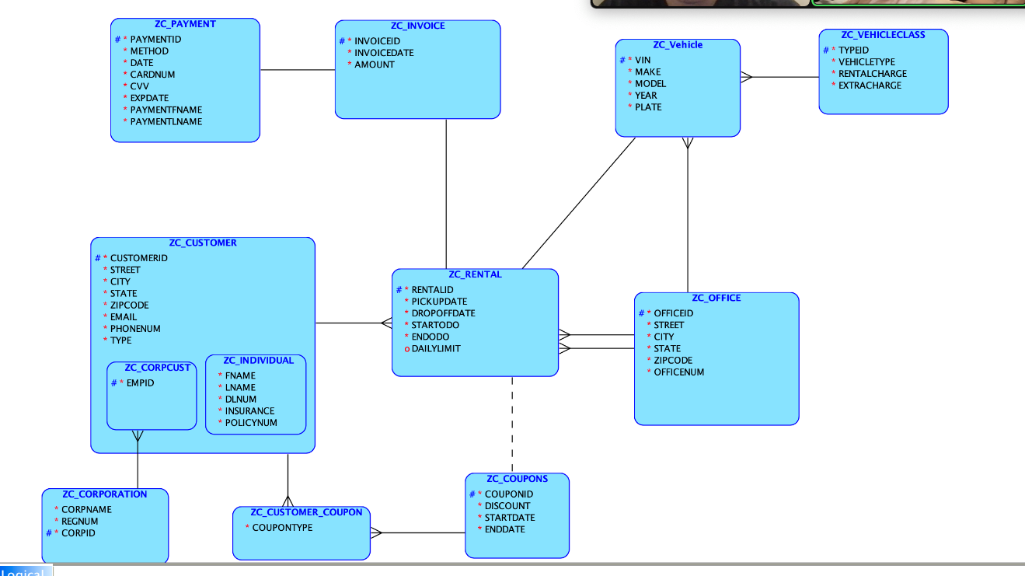
Logical Model

Slide 4
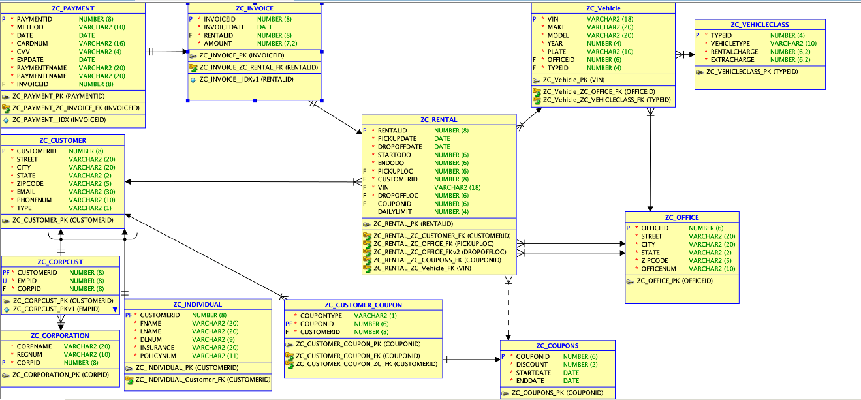
Relational Model

Slide 5
Systems used in this project
Design | Oracle Data Modeler
Code Editor | Visual Studio Code
Database | MySQL
Frontend | HTML
Backend | PHP
Server | Apache Web Server

Slide 6
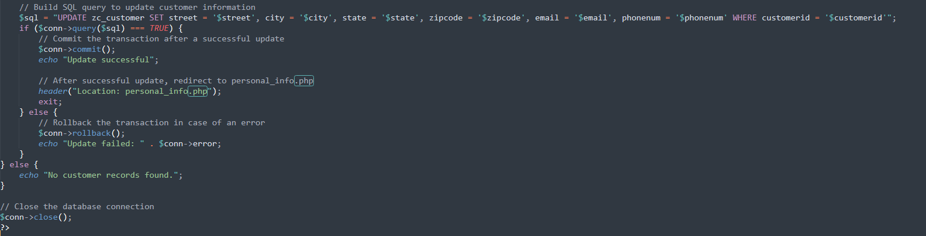
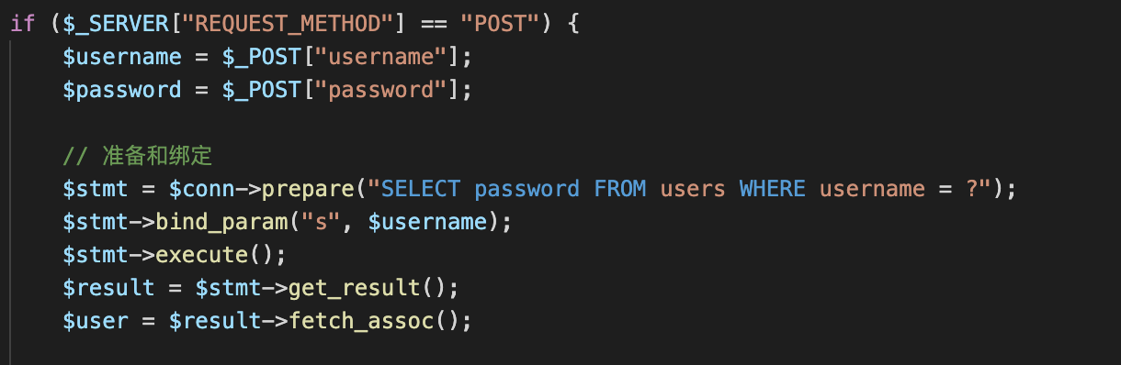
Protection against deadlocks and SQL injections

Slide 7
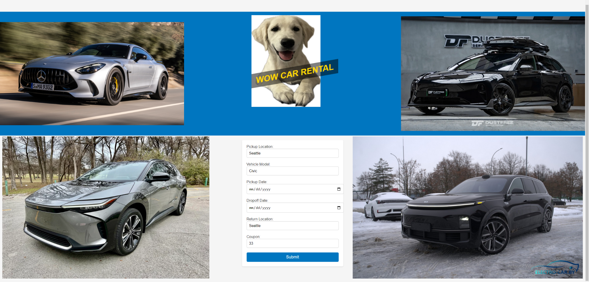
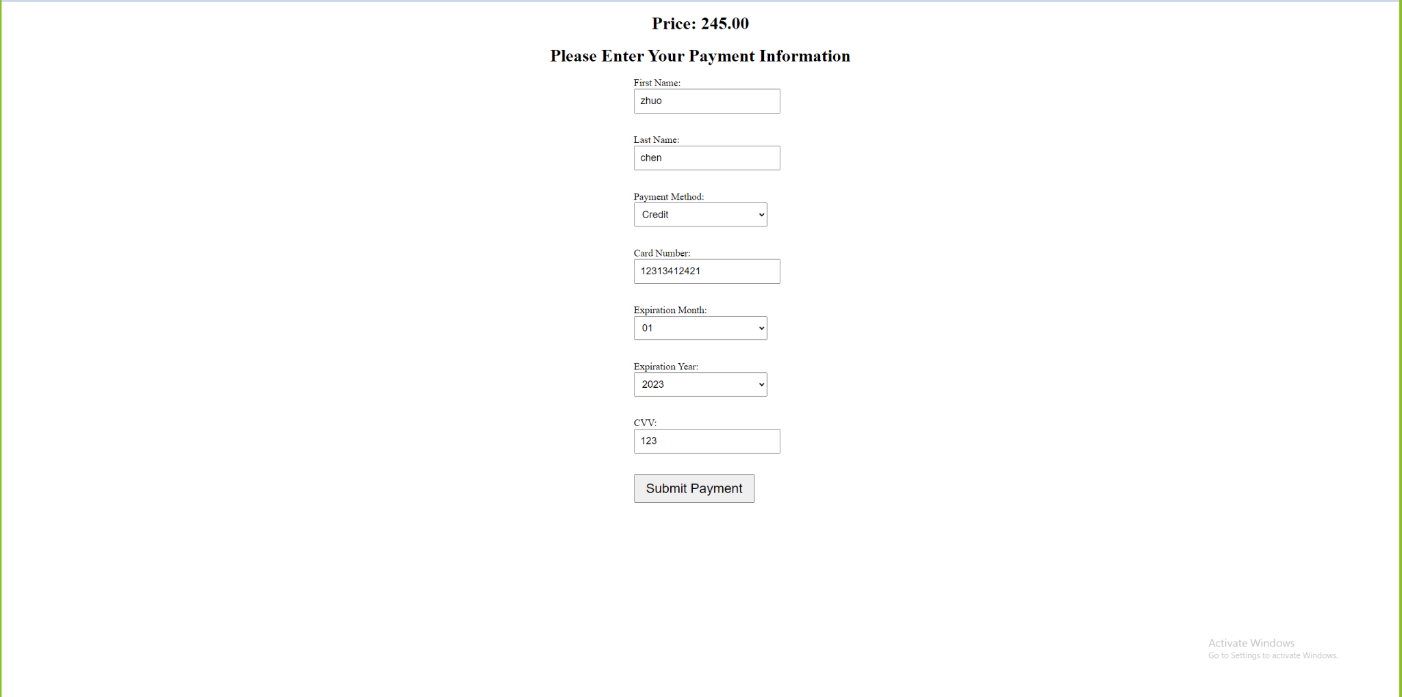
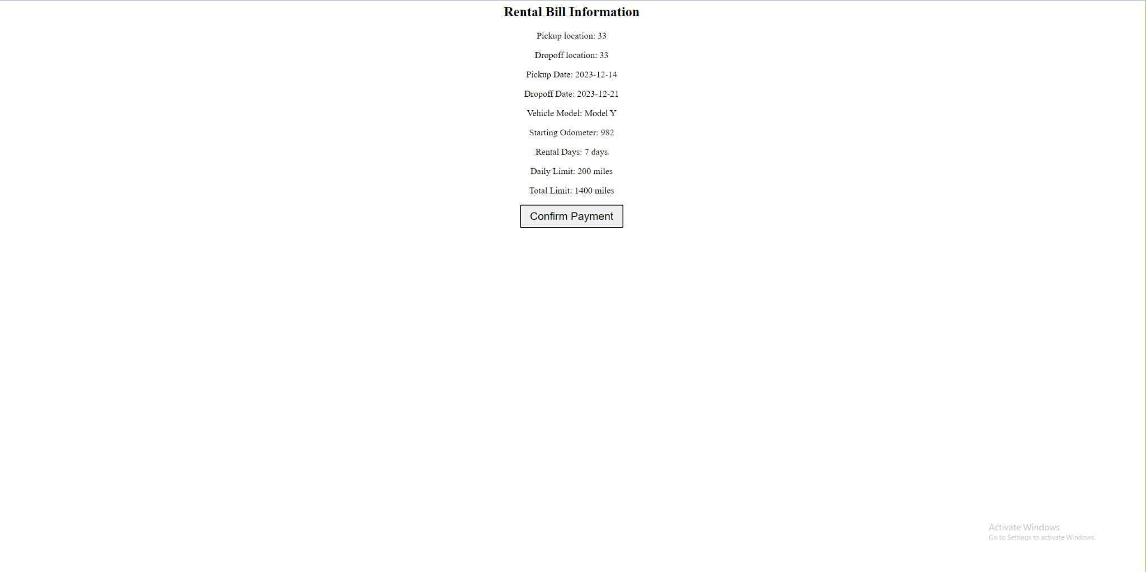
Screenshots

